Slide 1


Manufacturing Copilot : AI-powered Assistant for Production, Scheduling & Maintenance Theme: AI for Industry - Manufacturing Copilot (Gen AI + Agents)
Business Need/Business Problem Statement
Manufacturing planners and supervisors waste hours every day switching between ERP, MES, spreadsheets, and emails to check schedules, material availability, operator performance, and downtime logs.
This fragmented process leads to slow decisions, missed delivery commitments, reactive maintenance, and productivity loss directly impacting delivery performance and operational efficiency.
Key Solution Highlights
One stop conversational interface for all production, scheduling, and maintenance queries.
Hierarchical reasoning with specialized agents for Scheduling, Maintenance, and Inventory/Suppliers.
Reverse scheduling powered by ML models (lead time, buffer, shipping, production time).
Context-aware retrieval (RAG) from a Vector DB of SOPs, manuals, and downtime logs.
Automated actions: work orders, supplier notifications, and schedule updates.
Modular & scalable architecture that integrates easily with multiple ERP/MES systems.
Value/Benefits – Cover quantitative metrics, key business impact
Faster Decisions → Reduce manual scheduling effort by ~60%, enabling planners to respond instantly to order or production changes.
Improved Delivery Performance → Increase on-time deliveries by 10–15% through accurate reverse scheduling and predictive insights.
Reduced Downtime → Cut unplanned machine downtime by ~20% with proactive maintenance recommendations.
Productivity Boost → Free up several hours per supervisor per day by eliminating system-hopping and manual cross-checking.
Scalable & Future-Ready → Modular design allows easy addition of new capabilities like quality checks energy optimization, and supplier collaboration.
Reduces Mean Time to Resolution (MTTR)

Slide 2






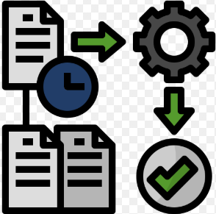
Solution Overview & Features
A LLM & Hierarchical Reasoning Model (HRM) powered conversational copilot that integrates ERP data, predictive ML scheduling models, and maintenance logs to answer operational queries, run reverse scheduling, and trigger actions all in natural language.
Foreseen Outcome
Solution Approach
Human + AI Collaboration
AI handles data-heavy tasks and reasoning.
Human supervisors retain control with full visibility into decision logic.
Natural Language Queries
Increased Engineer Productivity
Scalable Modular Design
Easily extendable with new agents (e.g., Quality Inspection, Energy Optimization).
No changes needed to the core architecture.
Higher Accuracy
Reverse Scheduling
Context-Aware Knowledge Retrieval (RAG)
Vector database stores SOPs, manuals, and logs.
Enables instant troubleshooting and process guidance.
Automated Actions​
Predictive Maintenance
Hierarchical Reasoning Mechanism (HRM)
A Supervisor Agent decomposes high-level queries into sub-tasks.
Specialized agents handle Scheduling, Maintenance, Inventory, and Supplier coordination.
This layered approach improves accuracy, traceability, and explainability of decisions.
End-to-End Orchestration
Seamless flow: Data ingestion → ML prediction → Action execution
All within a single conversational interface.
LLM-Powered Query Understanding
The conversational copilot uses a Large Language Model (LLM) to interpret complex manufacturing queries.

Slide 3
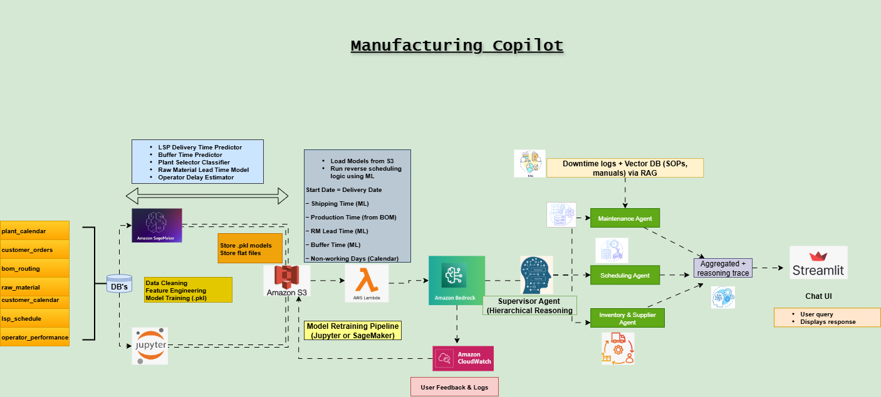
Architecture & Workflow

